Slide 1
Modeling phylogenetic change - Wrap up from last time
Breakout Groups
Questions:
1. Explain how you get the likelihood of a linear regression
Ex: X = [3,1,4]; Y = [5,2,9]; m = 1, b = 0, σ²=1 What's lnL? What does Maximum Likelihood mean?
2. What's the difference between Bayesian & Likelihood methods?
How does it differ in the Breast Cancer/Cowboy hat example and why?

Slide 2
Continuous-Time Markov Models
Markov assumption = probability of change depends only on current state, not how long it has been in that state

Slide 3
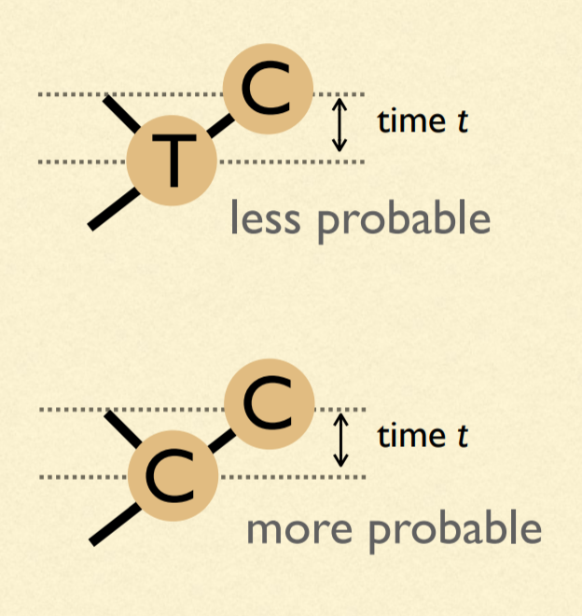
Our model of change depends on time: We must estimate branch lengths
Units of branch length will be expected number of substitutions per site
(= rate of substitions x time)

Slide 4
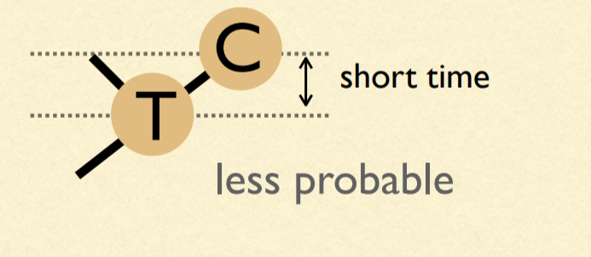
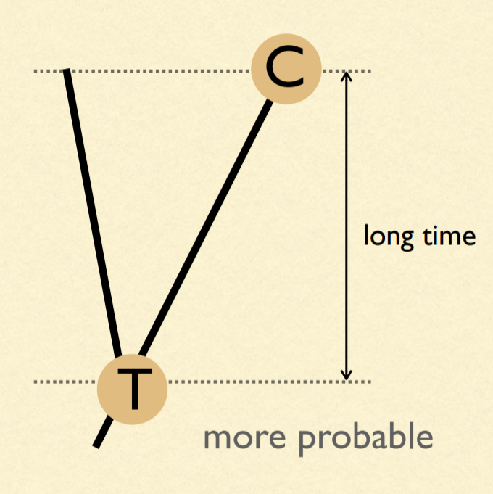
Probabilities are dependent on time

Slide 5
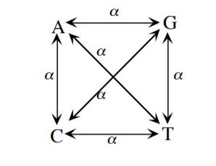
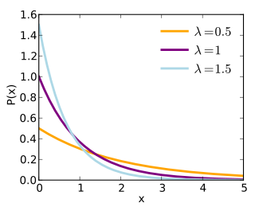
Poisson Process
Expected number of events ~ Poisson (λt)
Interinterval time ~ Exponential (λ)
Mean = 1/λ
Jukes Cantor (JC69)
β
β
β
β
β
β

Slide 6
μ = 4β
A
β
β
β
β
A
T
G
C

Slide 7
A (very) simple phylogeny...
time
A
A
P_{AA} =
Probability nothing happened +
Probability something happened, but that the last thing that happened ended in an A

Slide 8
A (very) simple phylogeny...
time
A
A
P_{AA} = (e^{-μt} ) + (1 - e^{-μt})(1/4)
Probability something doesn't happen
Probability at least one thing happens
Probability that the last thing that happened ends in an A
(π_{A}= π_{G} = π_{C} = π_{T} = 1/4)

Slide 9
A (very) simple phylogeny...
time
A
G
P_{AG} = (1 - e^{-μt})(1/4)
Probability at least one thing happens
Probability that the last thing that happened ends in an G

Slide 10
A (very) simple phylogeny...
time
A
C
P_{AC} = (1 - e^{-μt})(1/4)
Probability at least one thing happens
Probability that the last thing that happened ends in an C

Slide 11
A (very) simple phylogeny...
time
A
T
P_{AT} = (1 - e^{-μt})(1/4)
Probability at least one thing happens
Probability that the last thing that happened ends in an T

Slide 12
One last bit...substitutions vs. "events"
ν = (3/4)μt = 3βt
4ν/3 = μt
Only 3 out of 4 events results in a substitution. Thus, we can define the substitution rate ν.

Slide 13
P_{AA} = (e^{-μt} ) + (1 - e^{-μt})(1/4)
P_{AG} = (1 - e^{-μt})(1/4)
P_{AC} = (1 - e^{-μt})(1/4)
P_{AT} = (1 - e^{-μt})(1/4)

Slide 14
P_{AA} = (1/4) + (3/4)(e^{-4ν/3} )
P_{AG} = (1/4) - (1/4)(e^{-4ν/3})
P_{AC} = (1/4) - (1/4)(e^{-4ν/3})
P_{AT} = (1/4) - (1/4)(e^{-4ν/3})
Sanity check: Do they all add to 1?

Slide 15
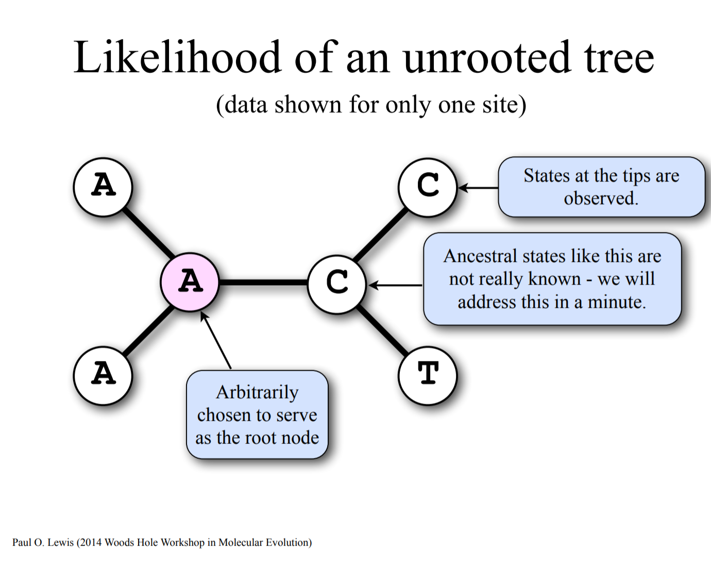

Slide 16
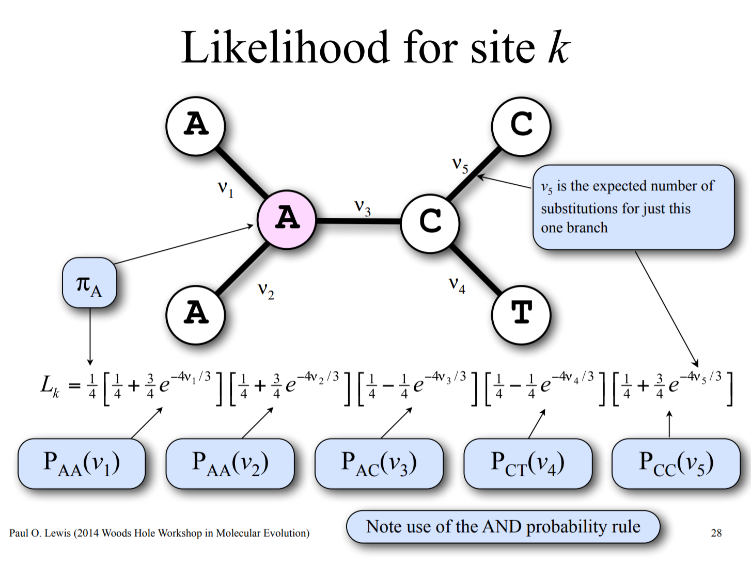

Slide 17
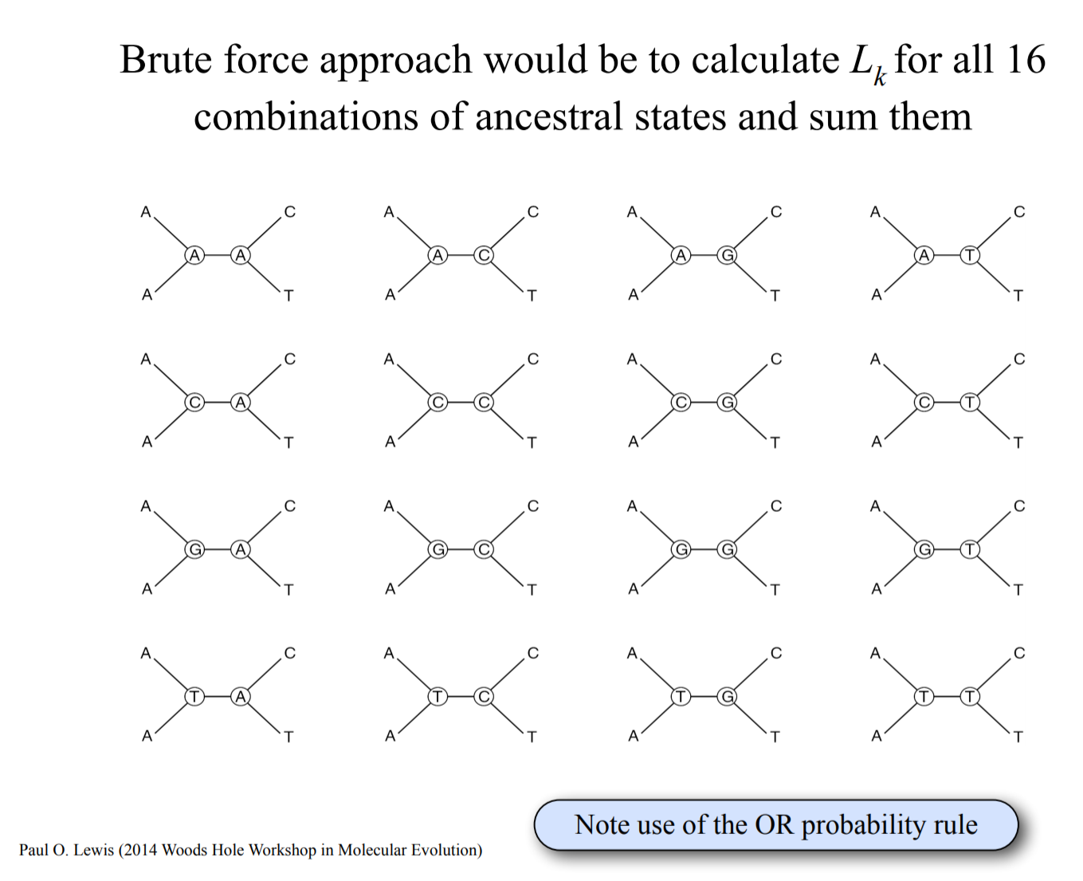

Slide 18
Pruning algorithm

Slide 19
Pruning algorithm

Slide 20
Pruning algorithm

Slide 21
Pruning algorithm

Slide 22
Pruning algorithm

Slide 23
Pruning algorithm

Slide 24
Pruning algorithm

Slide 25
Pruning algorithm

Slide 26
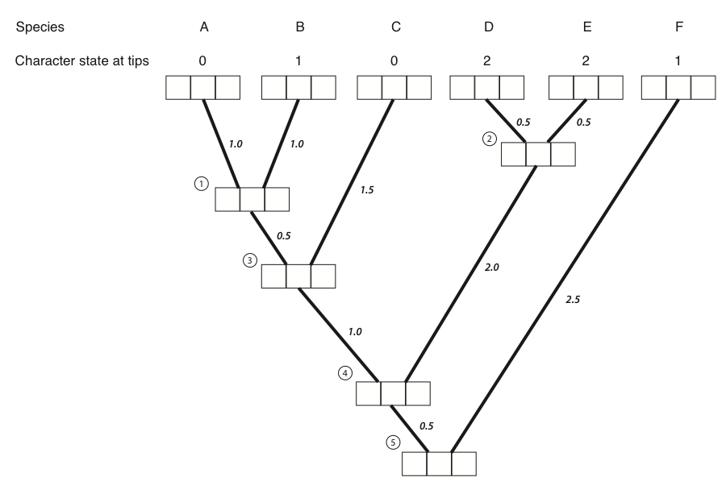
1 0 0
0 1 0
1 0 0
0 0 1
0 0 1
0 0 1

Slide 27
1 0 0
0 1 0
1 0 0
0 0 1
0 0 1
0 0 1
0.12 0.12 0.1

Slide 28
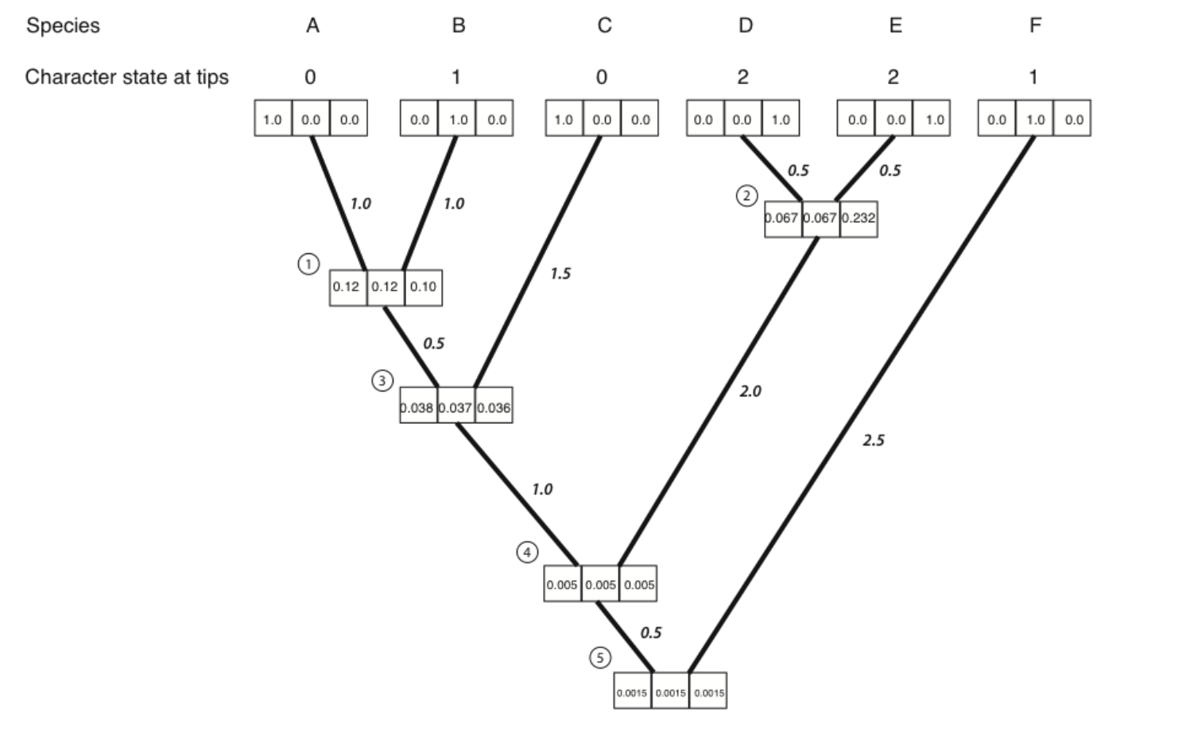

Slide 29
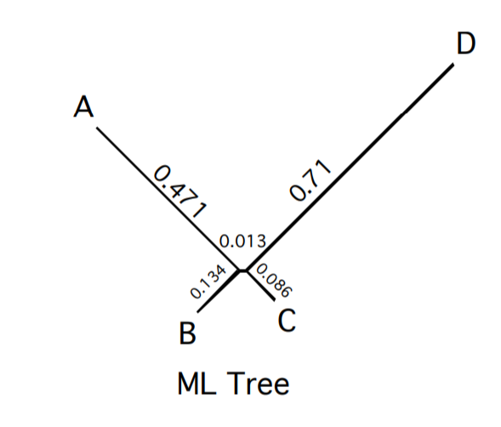
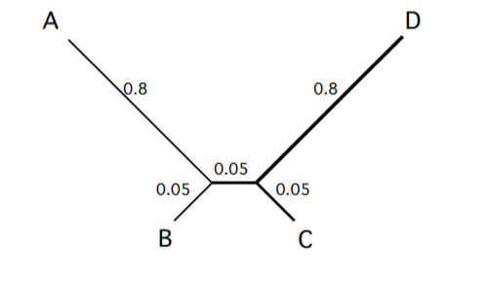
Returning to our original problem:
True Tree

Slide 30
Jukes-Cantor Model (JC69)
Q matrix (instantaneous rates)
A C G T
A -3β β β β
C β -3β β β
G β β -3β β
T β β β -3β
Q =

Slide 31
Jukes-Cantor Model (JC69)
Transition probabilities:
P = e^{Qt}
Matrix exponentiation

Slide 32
JC69 is our most basic model. We will be able to do amazing things with generalizations of this one model!
A C G T
A - β β β
C β - β β
G β β - β
T β β β -
Q =

Slide 33
Back to biology - Are JC69's assumptions realistic?
Assumptions of JC69:
1. All substitutions equally likely
2. Base frequencies equal
3. Every site has equal probability of substitution
4. Process is constant through time
5. Sites are independent of each other
6. Substitution is Markovian (memoryless)
7. All sites have the same evolutionary history
Can we relax any of these assumptions?

Slide 34
Back to biology - Are JC69's assumptions realistic?
Assumptions of JC69:
1. All substitutions equally likely
2. Base frequencies equal
3. Every site has equal probability of substitution
4. Process is constant through time
5. Sites are independent of each other
6. Substitution is Markovian (memoryless)
7. All sites have the same evolutionary history
Can we relax any of these assumptions?

Slide 35
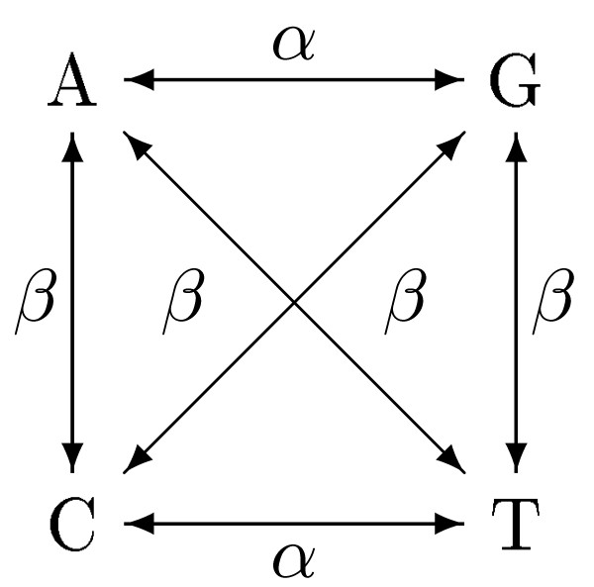
Kimura 2 Parameter model: K2P
A C G T
A - β α β
C β - β α
G α β - β
T β α β -
Q =

Slide 36
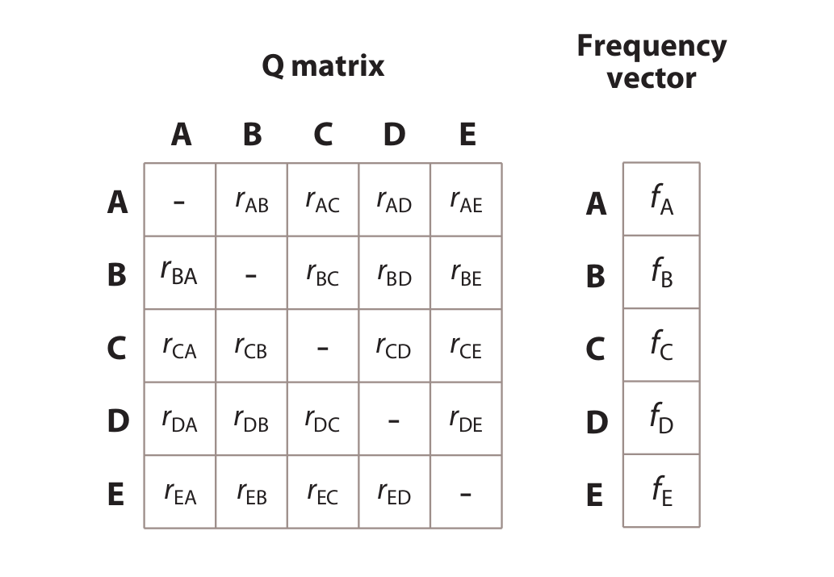
Our general CTMC model:

Slide 37
Differences between statistical phylogenetics and parsimony
We get branch lengths in expected number of changes rather than minimum # of changes
We expect and probabilistically incorporate all possible paths to the data, not just the shortest path
We have the flexbility to modify and compare models
We have a straight-forward way to convert branch lengths to time (with fossils or other constraints)
We use ALL OF THE DATA, not just parsimony-informative sites

Slide 38
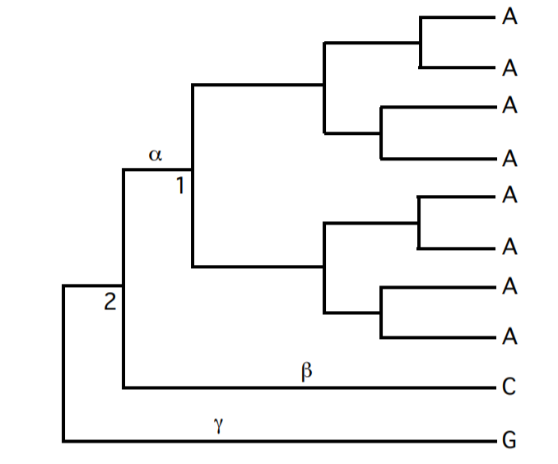
Example: Parsimony says node 2 can be either A, C, or G with equal number of steps.

Slide 39
Example: What evidence is here that says node 2 is more likely A, than C and G?

Slide 40
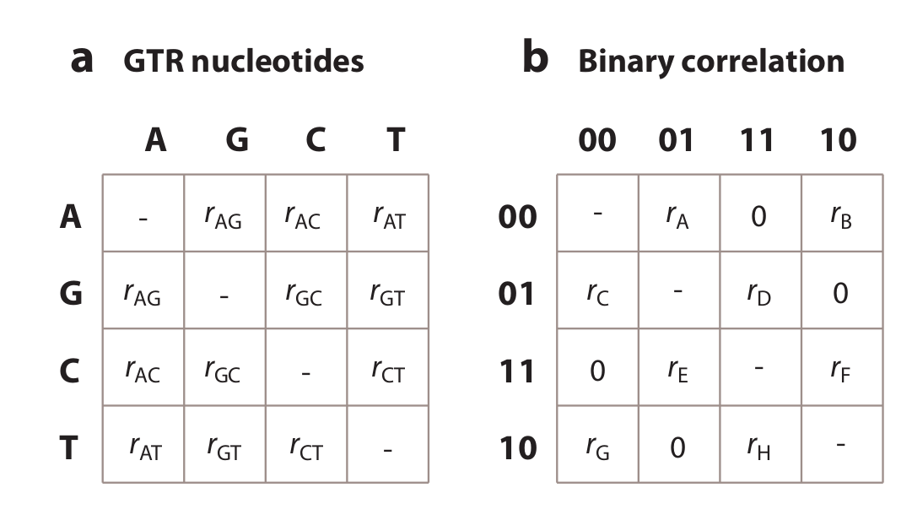
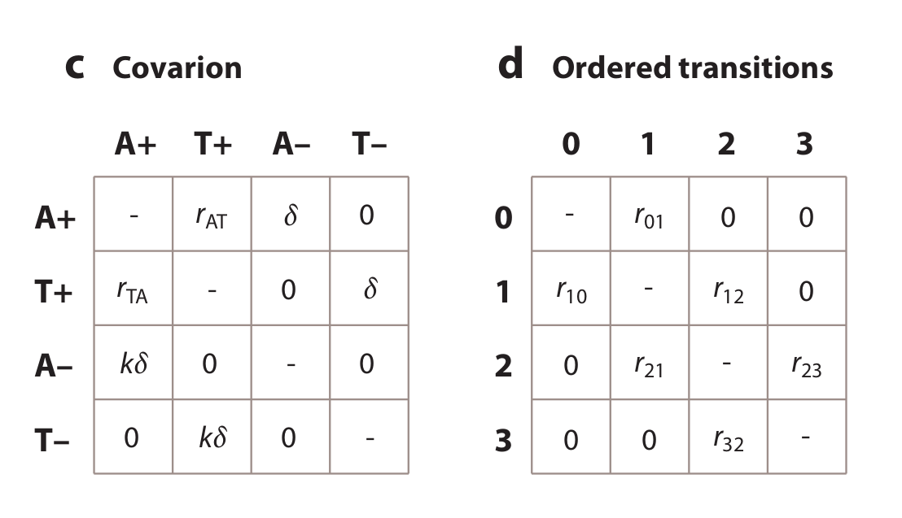
How many parameters for each? What do the models suggest about evolution?

Slide 41
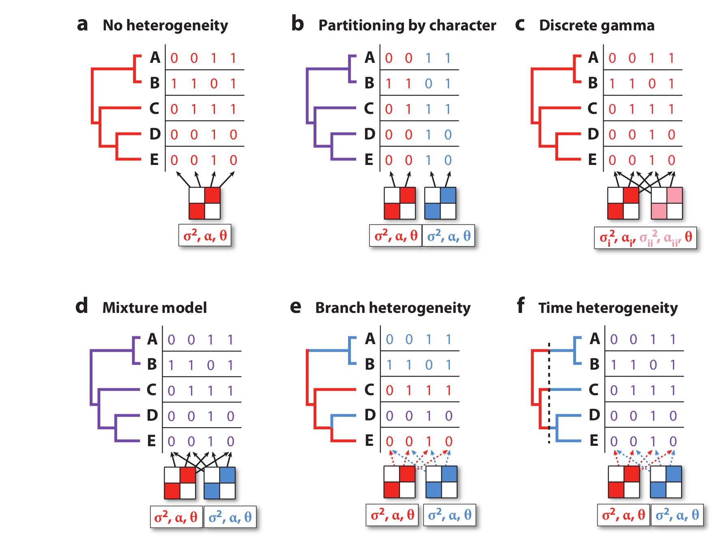
Dealing with among-site and time-heterogeneity

Slide 42
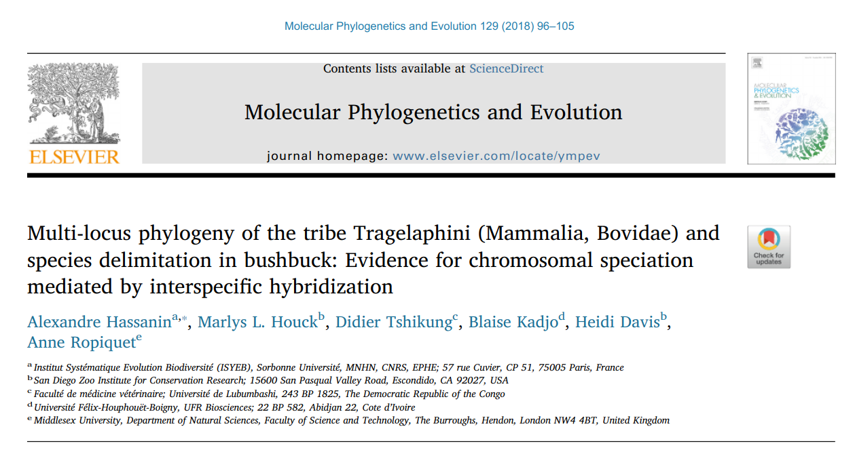

Slide 43
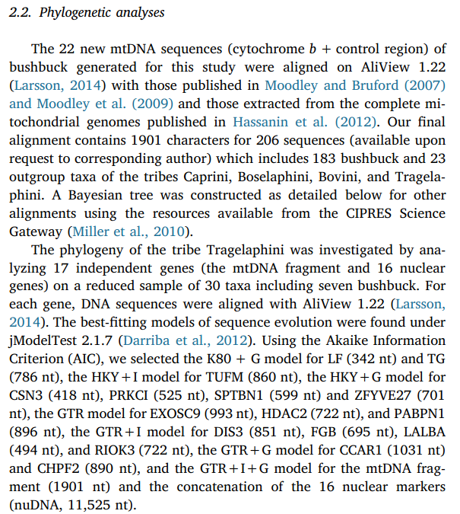

Slide 44
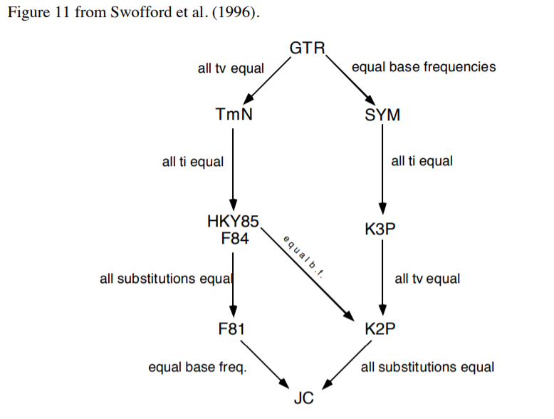

Slide 45
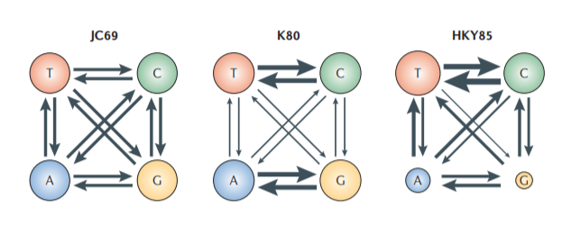
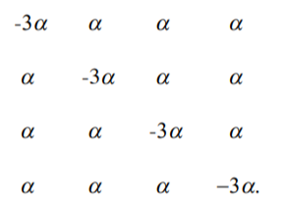
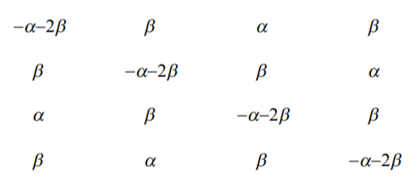
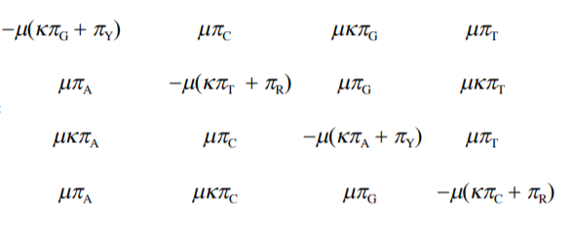

Slide 46
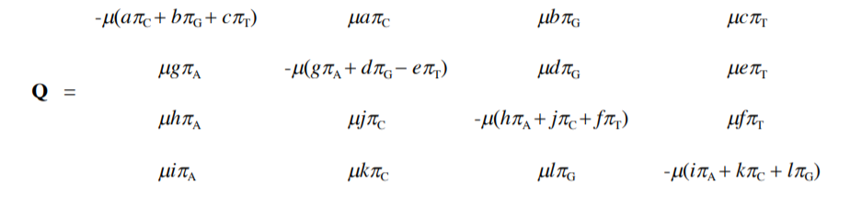
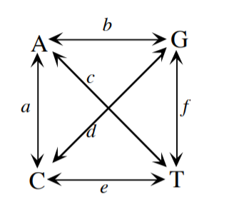
General Time-Reversible Model

Slide 47
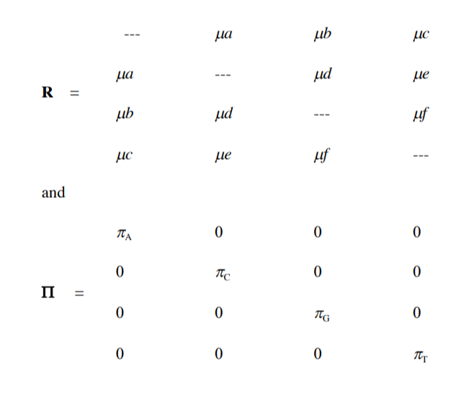
General Time-Reversible Model

Slide 48
Among-site rate variation

Slide 49
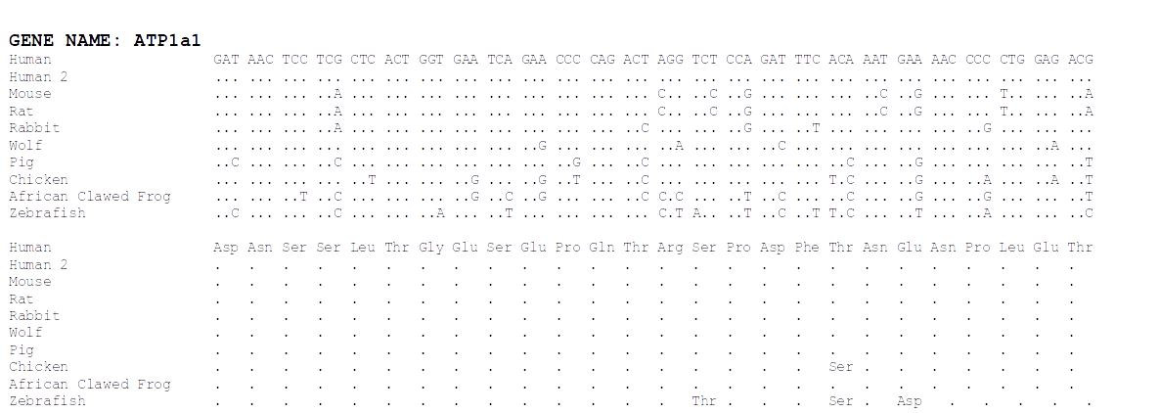
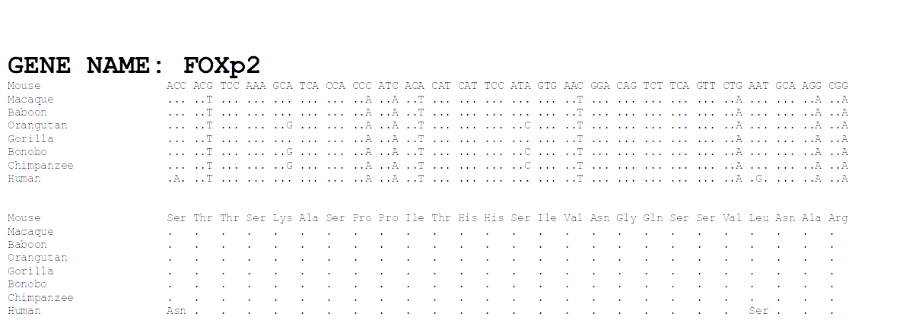

Slide 50
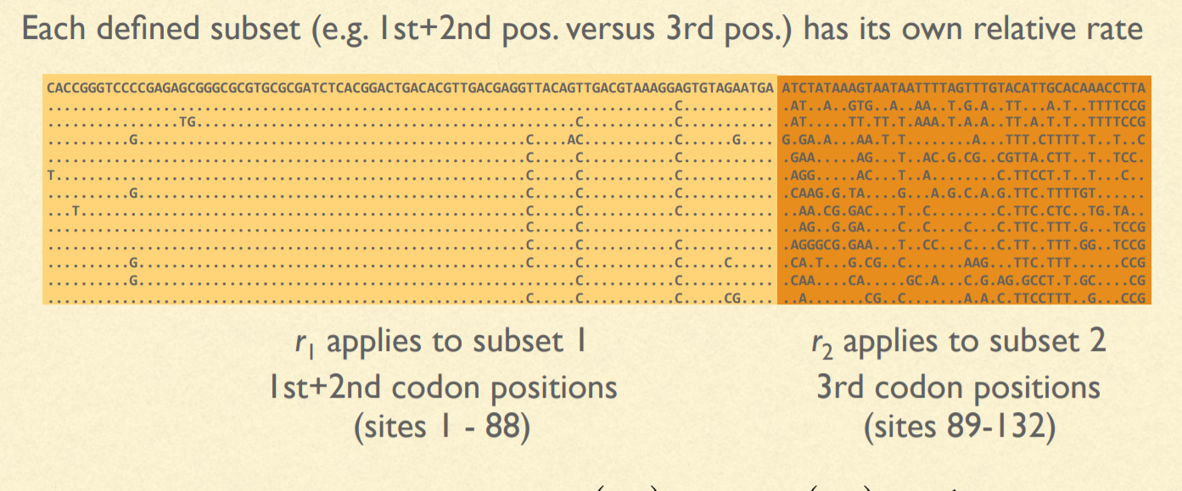
Site-specific rates

Slide 51
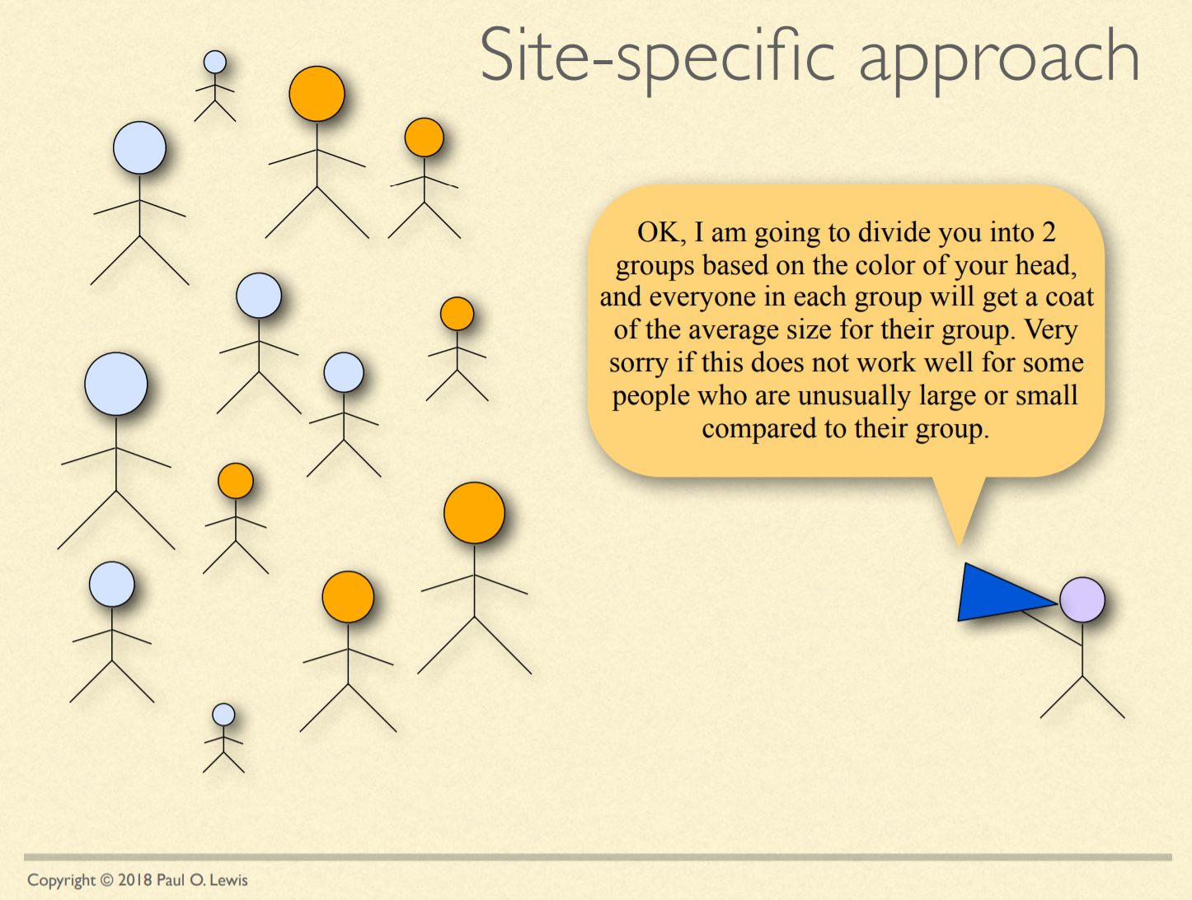

Slide 52
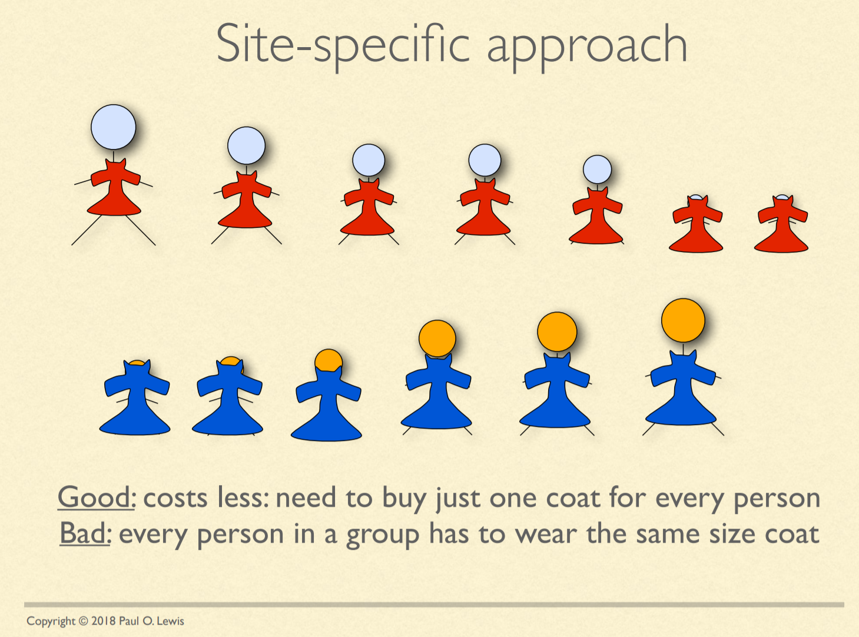

Slide 53


Slide 54
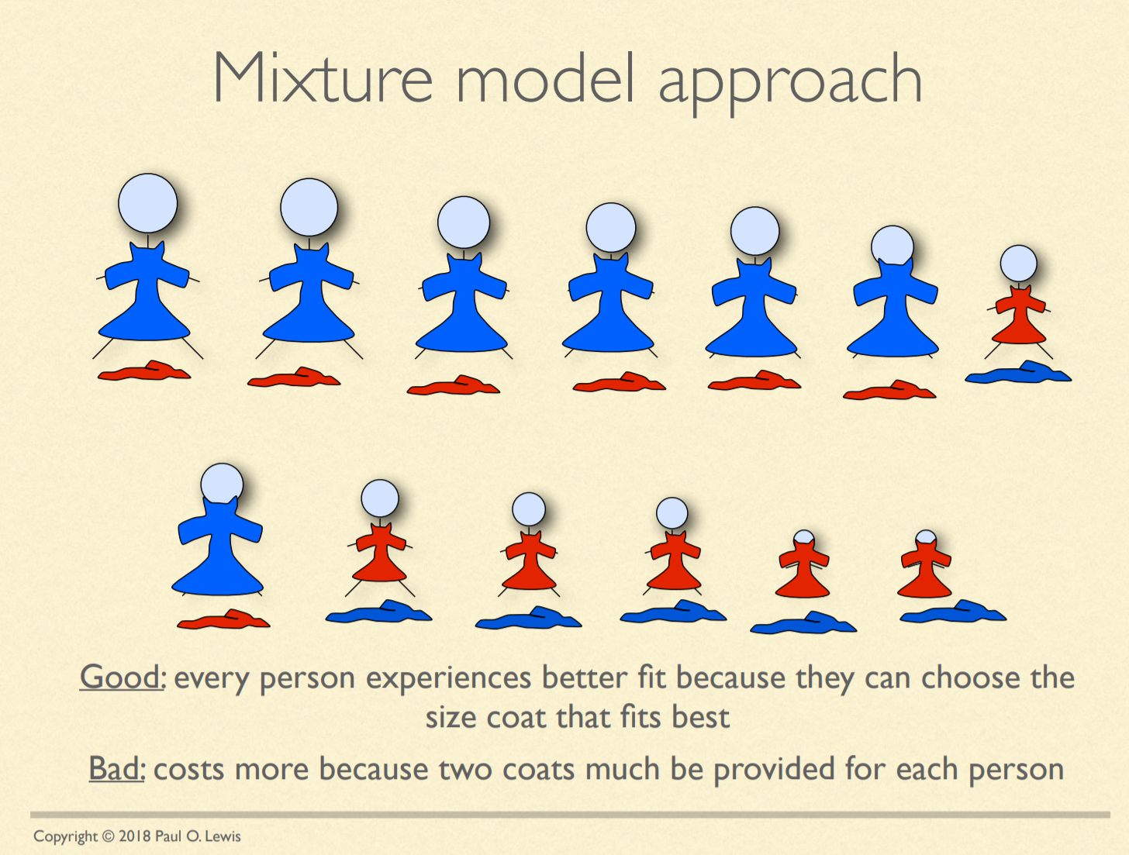

Slide 55
Invariable sites model
Every site has a probability, P_{invar} of being invariant
P_{invar} estimated from the data
Every site gets its likelihood estimated in two parts: If it were invariant & variable (as normal)
Often designated "+I" (e.g. HKY85 + I)

Slide 56
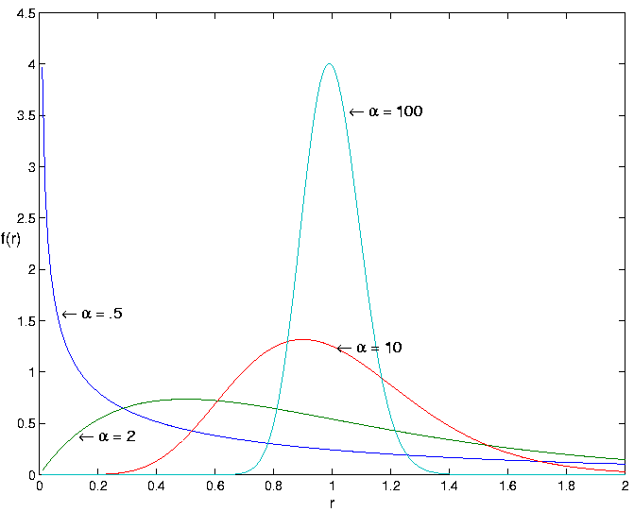
Gamma-distributed rates
Rate categories set by a discrete gamma distribution (e.g. 4 rate categories)
Estimate α
Site likelihoods calculated for each rate category and summed
"+G"
(e.g. HKY85 + I + G)

Slide 57
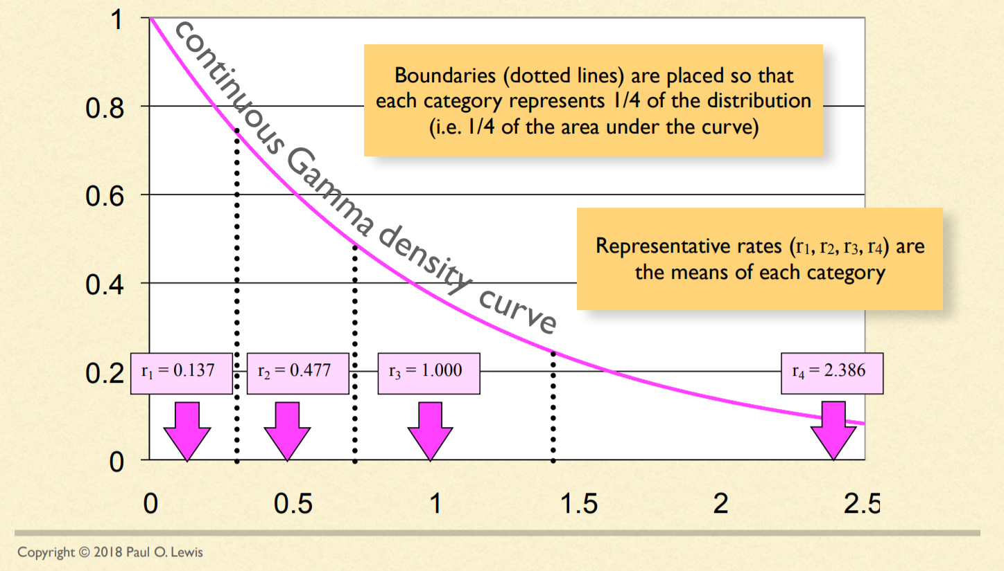
Discretizing the Gamma distribution

Slide 58
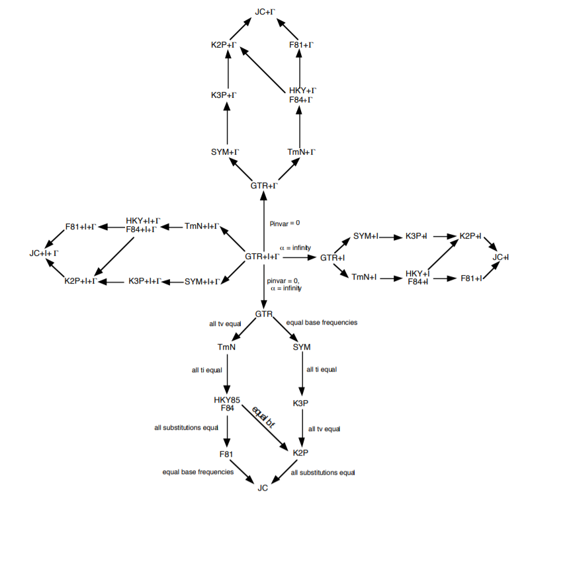
OK...but how do we decide which model to use?!?!

Slide 59
Model testing
Ideally, fit all models while simultaneously estimating tree
More practical:
Start with a not-too-bad tree, fit all the possible models, rank them by some criterion, pick the best one and use in a full analysis
Criteria: Likelihood ratio test, Akaike Information Criterion, Bayesian Information Criterion, Decision Theory, Bayesian model selection, Bayesian hypothesis testing or model averaging

